Slide 1


The Power of Data Science
Data science unlocks insights from vast datasets. It transforms raw data into actionable intelligence. The global data science platform market is projected to reach $300 billion by 2030. "Data Scientist" consistently ranks as a top job.

Slide 2

The Rise of Data-Driven Decisions
We generate 2.5 quintillion bytes of data daily. Advancements in computing power fuel this growth. Open-source tools like Python and R democratize access. Businesses demand predictive capabilities and automation.
1
Data Explosion
Massive daily data creation drives demand.
2
Computational Power
Cloud computing enables complex analysis.
3
Open-Source Tools
Accessibility of Python and R is key.
4
Business Demand
Predictive analytics powers innovation.

Slide 3

Data Science: A Multidisciplinary Field
Statistics & Mathematics
Computer Science
Domain Expertise
Machine Learning
Programming skills
Business context
Predictive models
Rigorous analysis
Algorithm design
Problem framing
Pattern recognition
Statistical modeling
Python, SQL expertise
Industry knowledge
Neural networks
Regression analysis

Slide 4






The Data Science Workflow
Problem Framing
Define clear objectives and KPIs.
Data Collection & Cleaning
Often 80% of project time is spent here.
Exploratory Data Analysis
Visualize data and discover patterns.
Model Building & Validation
Select algorithms and tune hyperparameters.
Deployment & Monitoring
Integrate and manage models in operations.

Slide 5





Essential Tools and Technologies
Programming Languages
Cloud Platforms
Big Data Frameworks
Python (Pandas, Scikit-learn), R, SQL are fundamental.
AWS SageMaker, Azure ML, Google AI Platform enable scalability.
Apache Spark and Hadoop process large datasets.
Visualization Tools
Tableau, Power BI, Matplotlib create impactful visuals.

Slide 6

Challenges and Future Trends
1
Data Quality & Governance
"Garbage in, garbage out" is a critical concern.
2
Interpretability & Bias
Ensuring fairness and explainable AI (XAI) is vital.
3
Ethical AI
Data privacy (GDPR, CCPA) and responsible use are key.
4
MLOps
Streamlining model deployment and lifecycle management.

Slide 7
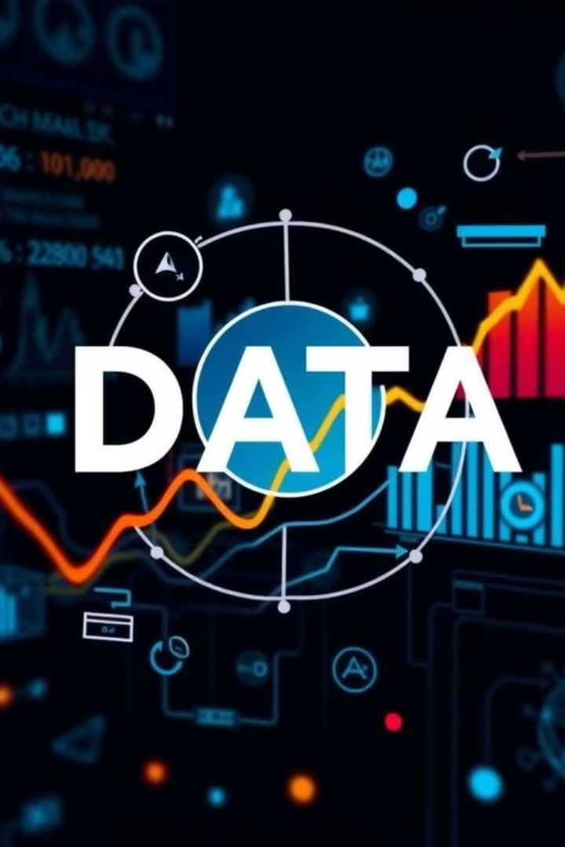
Conclusion: The Data-Driven Imperative
Competitive Advantage
Data science is critical for market leadership.
Innovation & Efficiency
It drives new opportunities and streamlined operations.
Continuous Learning
Adaptation and ongoing education are essential.
Embrace Culture
Foster a data-driven culture for future success.

Slide 8
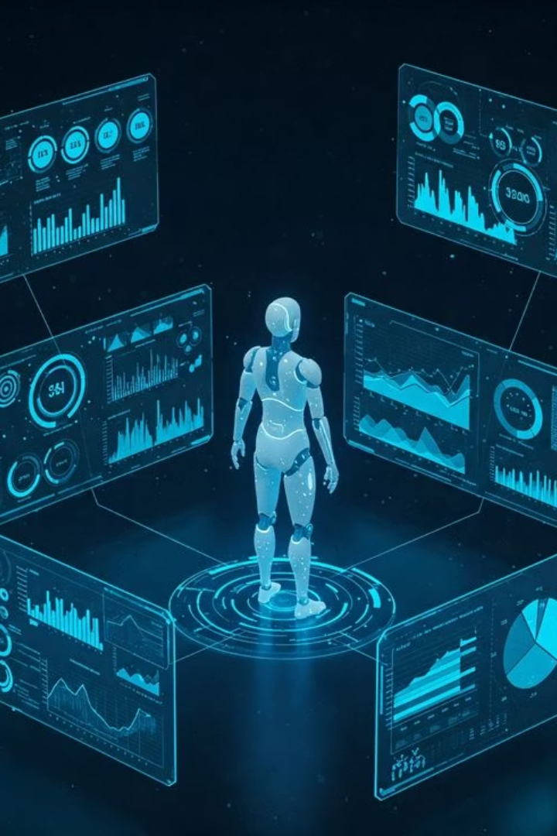
Thank You
Thank you for your time and attention. We are excited about the future of data science.

